Slide 1
Three Phase System
Lecture_2

Slide 2
Topics to Be Covered
Balance and Unbalanced load and Source
Possible Configurations
Relation between Line and Phase Voltage
Relation between Line and Phase Current
Mathematical Approach

Slide 3
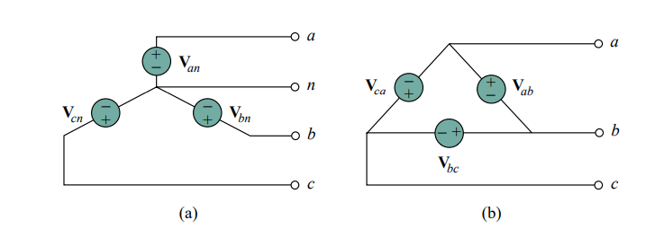
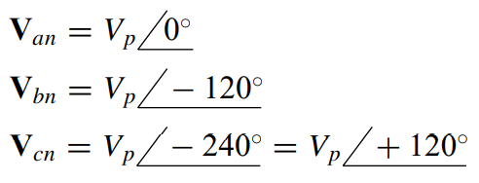
Balanced and Unbalanced Sources
Balanced phase voltages are equal in magnitude and are out of phase with each other by 120◦.
Example of Balance three phase system

Slide 4

Problem_1
Prove that, the summation of balance three phase voltages is zero.

Slide 5
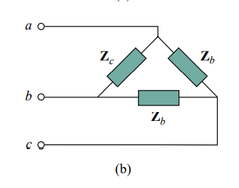
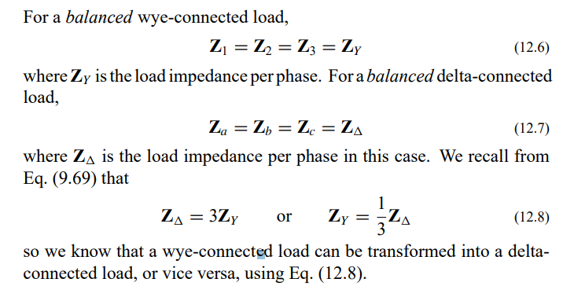
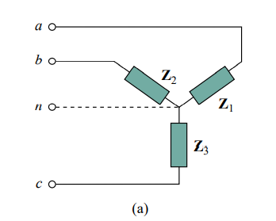
Balance Load
A balanced load is one in which the phase impedances are equal in magnitude and in phase.

Slide 6

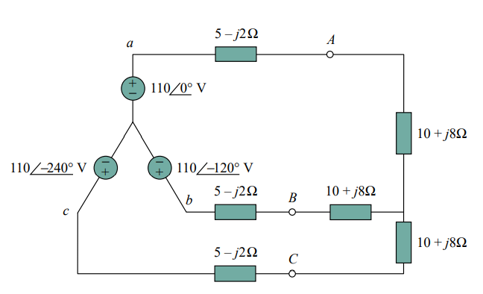
Mathematical Problems
Convert wye connected load into delta connected load

Slide 7
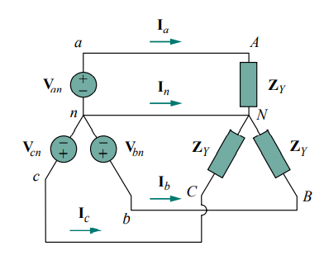
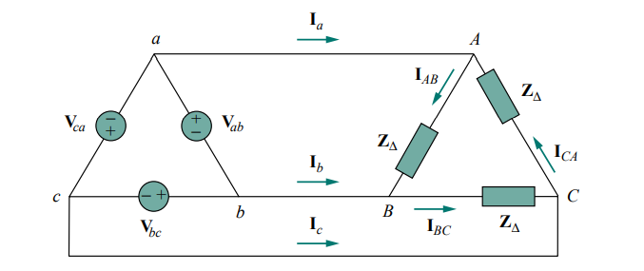
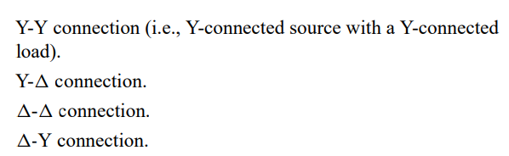
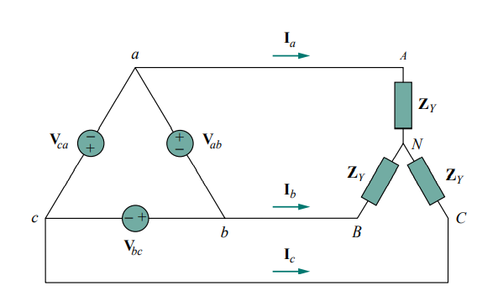
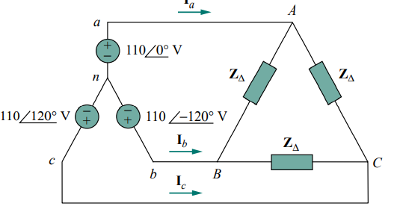
Possible Configuration

Slide 8

Problems of Delta-Wye System
In a wye-connected load, the neutral may not be accessible.
Delta connected sources are not common in practice because of the circulating current that will result in the delta-mesh if the three-phase voltages are slightly unbalanced

Slide 9
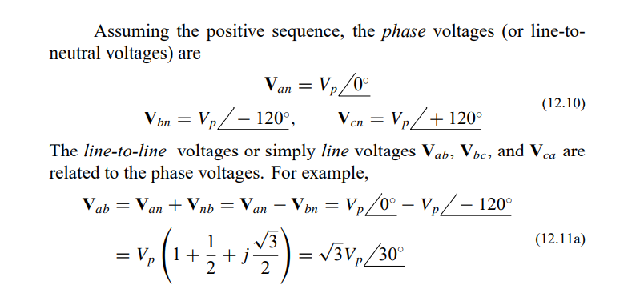
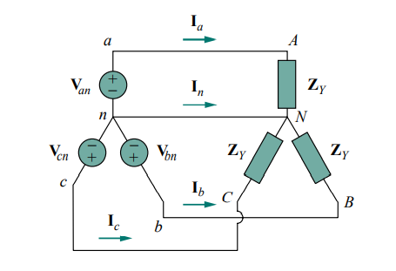
Relation between Line voltage and Phase Voltage

Slide 10
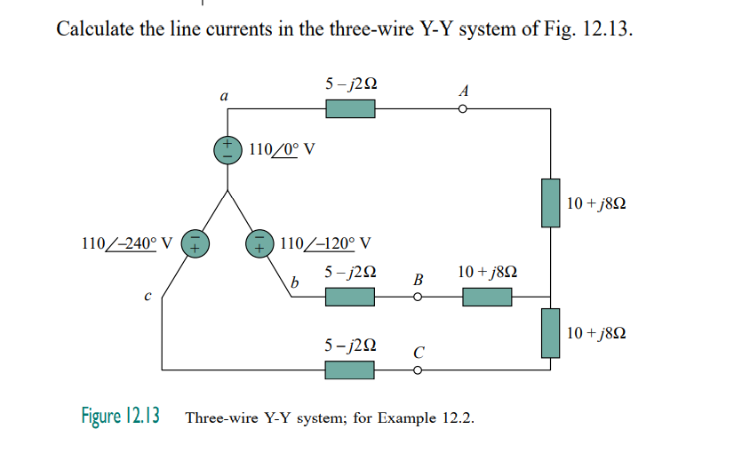
Mathematical Problem

Slide 11
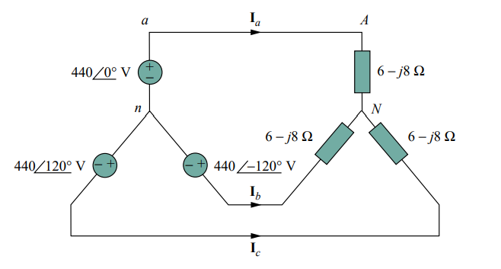
Mathematical Problem

Slide 12
Ready for Group Study

